Slide 1

Body Sideslip Control using Direct Yaw Moment Control (DYC)
Vehicle Dynamics & Control - R047017
By Group 5:
Neeraja Bhide (5495601)
Pavan Prasad H.G. (5508053)
Paul Kartoidjojo (4480961)
Anand Srikrishna (5306485)

Slide 2
Table of contents
Motivation
Problem Statement
Control Strategies
Vehicle Validation Model
Test Manoeuvre
Simulation & Results
Conclusion
Further Possibilities

Slide 3
Motivation

Slide 4
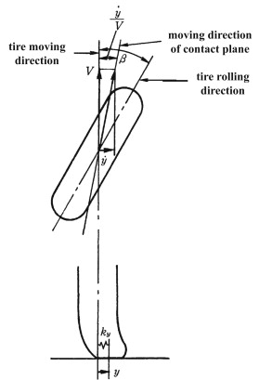
Motivation:
Vehicle sideslip angle is a major indicator of dynamics stability for ground vehicles. [2]
Sideslip angle can provide important information for direction stability control systems. [3]
Disadvantage:
The vehicle sideslip angle is immeasurable with commercially-available sensors.
[3]

Slide 5
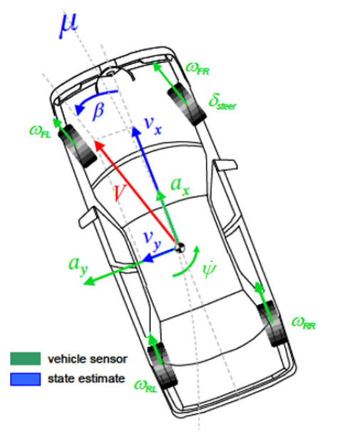
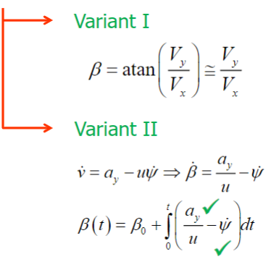
Measure/Estimate Sideslip Angle:
Estimations and computations performed in a control loop can be erroneous and lead to instability
[1]
Notes:
There are 2 ways to measure sideslip angle as seen here :
In the first, we need to use expensive sensors or state estimation.
In the second, we have abundantly available sensors (accelerometers and yaw rate sensors), indicated by the tick marks, thus making the second one cheaper.
However, since we mostly simulate here, we use the first variant more often and use the second in a particular case where we require beta dot.
Estimations and computations performed in a control loop can be erroneous and lead to instability. This makes controlling sideslip (along with important parameters like yaw rate difficult)

Slide 6
Problem Statement

Slide 7
Problem Statement
“ Vehicle stability control from body Sideslip Control using Direct Yaw Moment Control”

Slide 8
Control Strategies

Slide 9
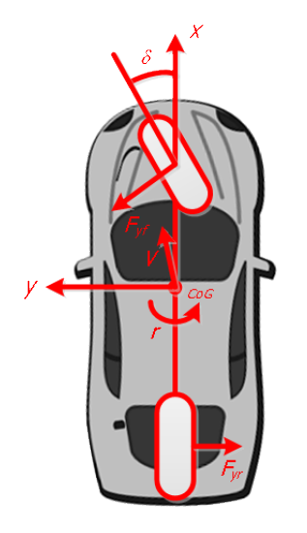
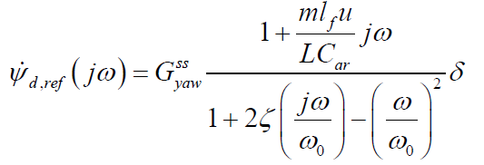
Reference Generator
Reference yaw rate (r_{d,ref}) is generated from the steering wheel angle δ input using the bicycle model second-order transfer function

Slide 10
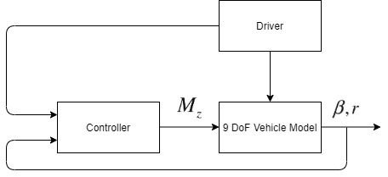

Direct Yaw moment Control
Error Yaw rate is fed into the controller.
LQR controller is designed considering the control input dM_{Z}

Slide 11
Control Strategies
Direct Yaw Moment Control (DYC) with PD Control of Sideslip angle
Direct Yaw Moment Control (DYC) with reference correction
Direct Yaw Moment Control (DYC) with the saturation of yaw rate
Notes:
\

Slide 12

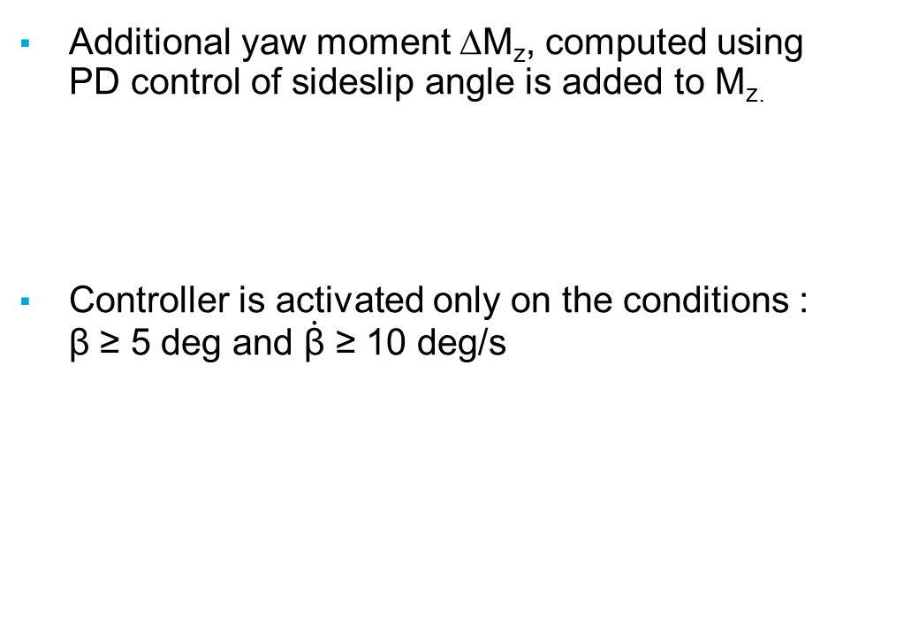
PD Control of Sideslip angle
Additional yaw moment ∆M_{z}, computed using PD control of sideslip angle is added to M_{z.}
Controller is activated only on the conditions : β ≥ 5 deg and $\dot{\text{β}}$ ≥ 10 deg/s
Notes:
\

Slide 13
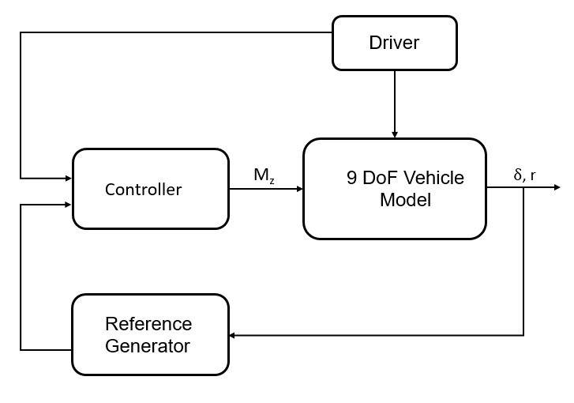



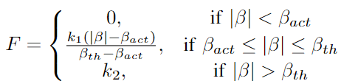
With reference correction
Adjustments are adopted to reference generator [4]
We can tune positive Constants k₁ and k₂
Notes:
\

Slide 14
With reference correction
Adjustments are adopted to reference generator [4]
We can tune positive Constants k₁ and k₂

Slide 15


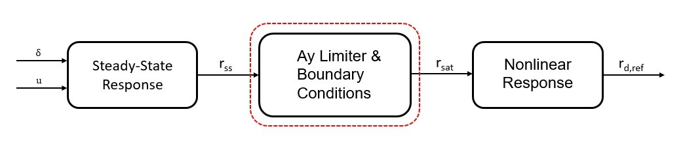


With yaw rate saturation
Limitation is introduced on the maximum lateral acceleration and maximum sideslip angle [1]
Reference sideslip angle is assigned as
The maximum yaw rate is thus obtained as
Steady state yaw rate is assigned with

Slide 16
Vehicle Validation Model

Slide 17
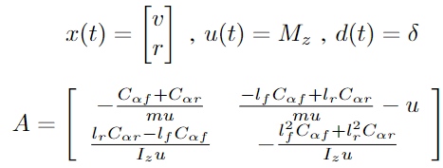


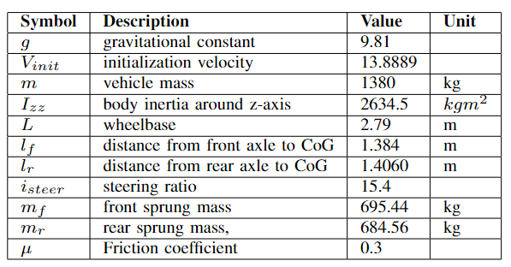
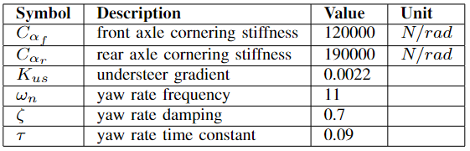
Vehicle validation model
Linear Bicycle model : [5]
Notes:
\

Slide 18
Test Manoeuvre

Slide 19
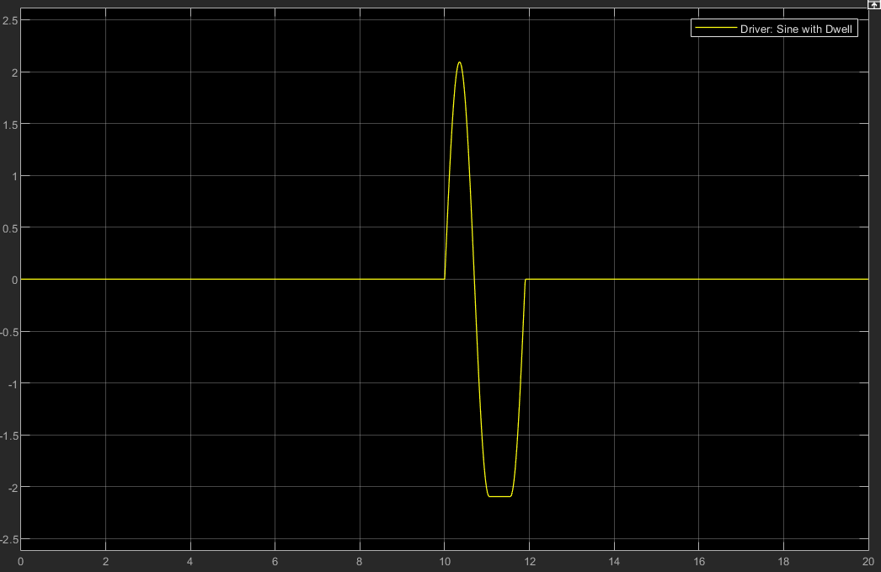
Sine with Dwell (SwD)
Sine with Dwell (SwD) test (ISO 19365:2016) is performed.
SwD manoeuvre is the worst-case scenario test used to test vehicle stability.
Reference longitudinal velocity is 100 kmph and friction coefficient is 0.3.
Low friction coefficient is considered to simulate higher sideslip angle evolution.

Slide 20
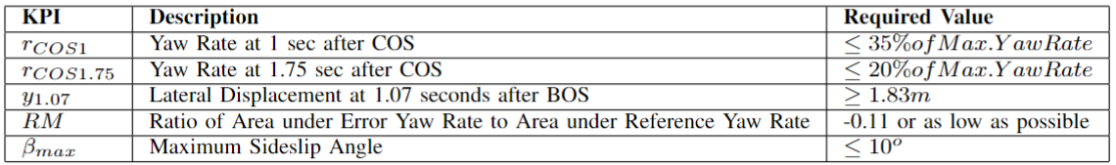
Lateral Stability Criterion for SwD [6]
Notes:
\

Slide 21
Simulation & Results

Slide 22
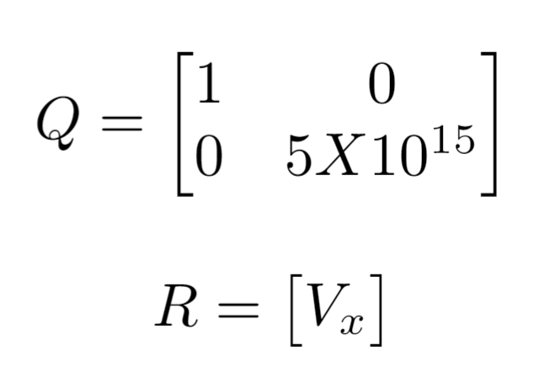
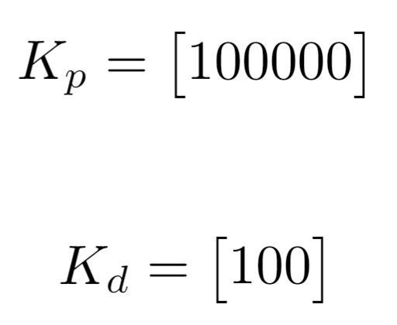
Controller Parameters
LQR -
PD -
Reference Correction - k₁ is set as 0.85 and k₂ is set as 1
Notes:
\

Slide 23
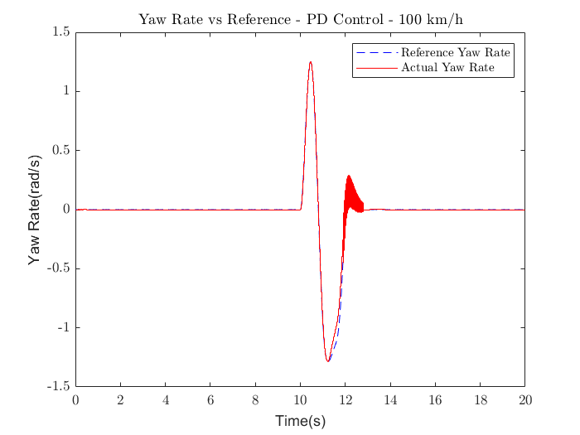
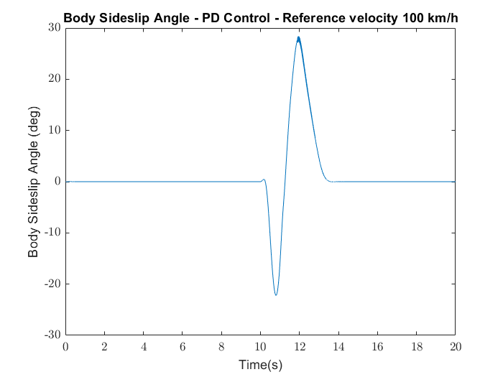
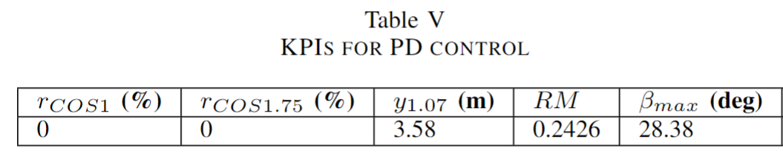
Performance – PD Control of Sideslip
Notes:
\

Slide 24
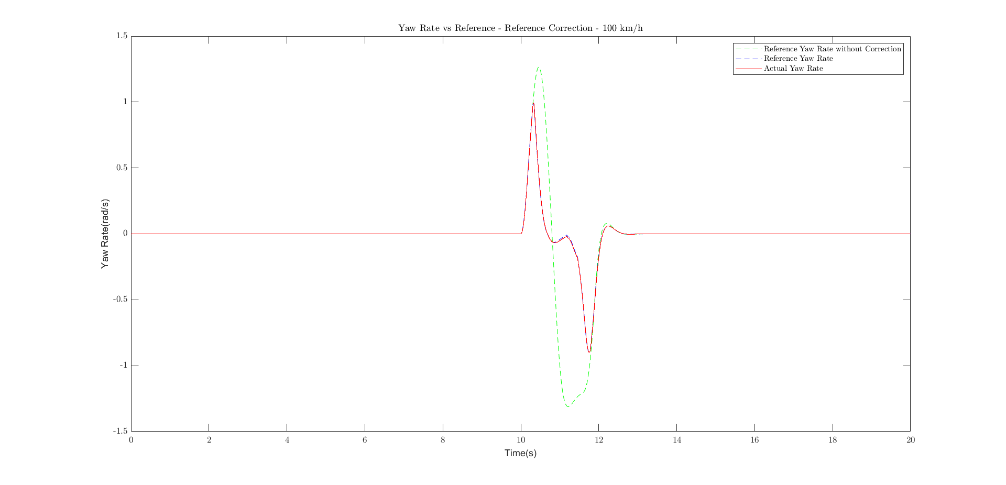
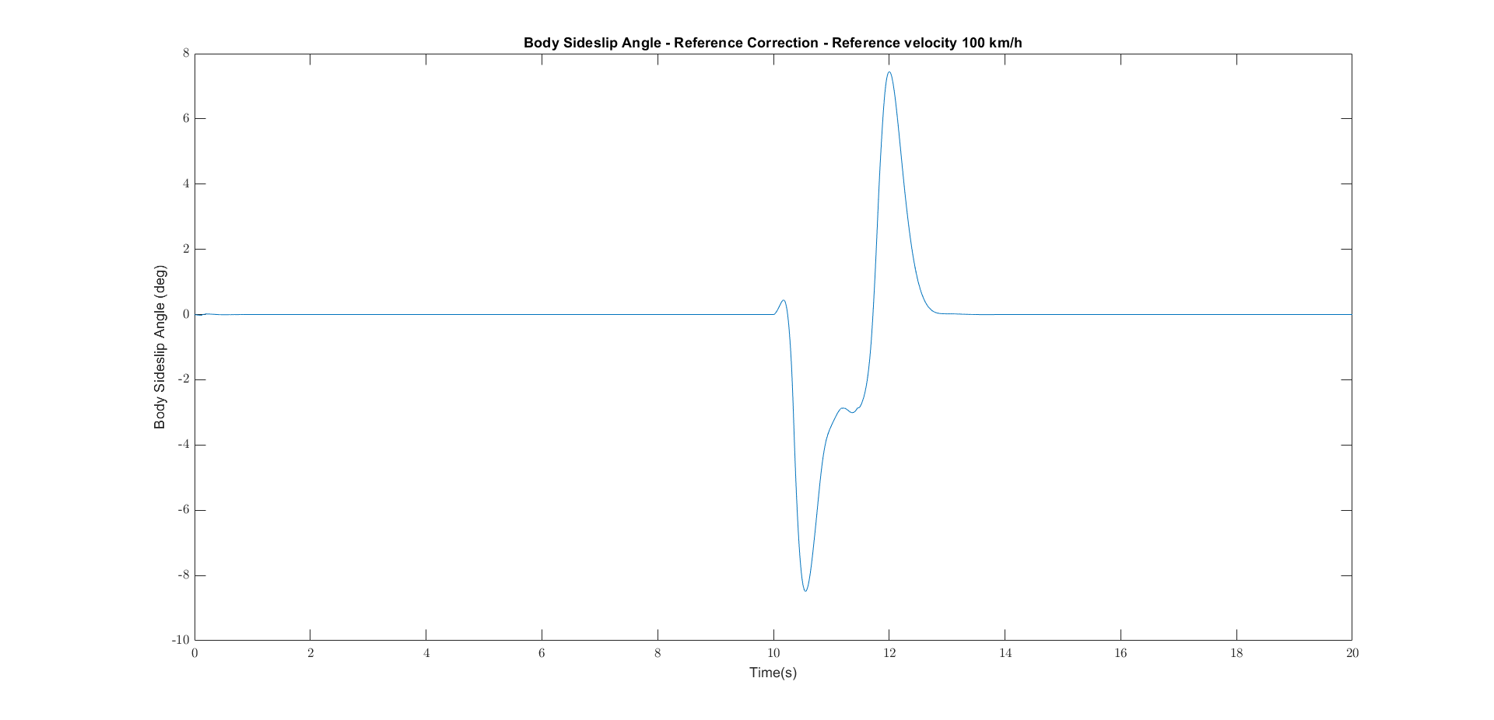
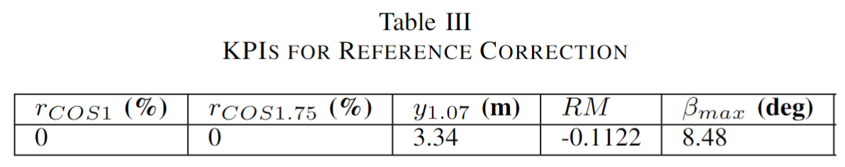
Performance – Reference Correction Method
Notes:
\

Slide 25
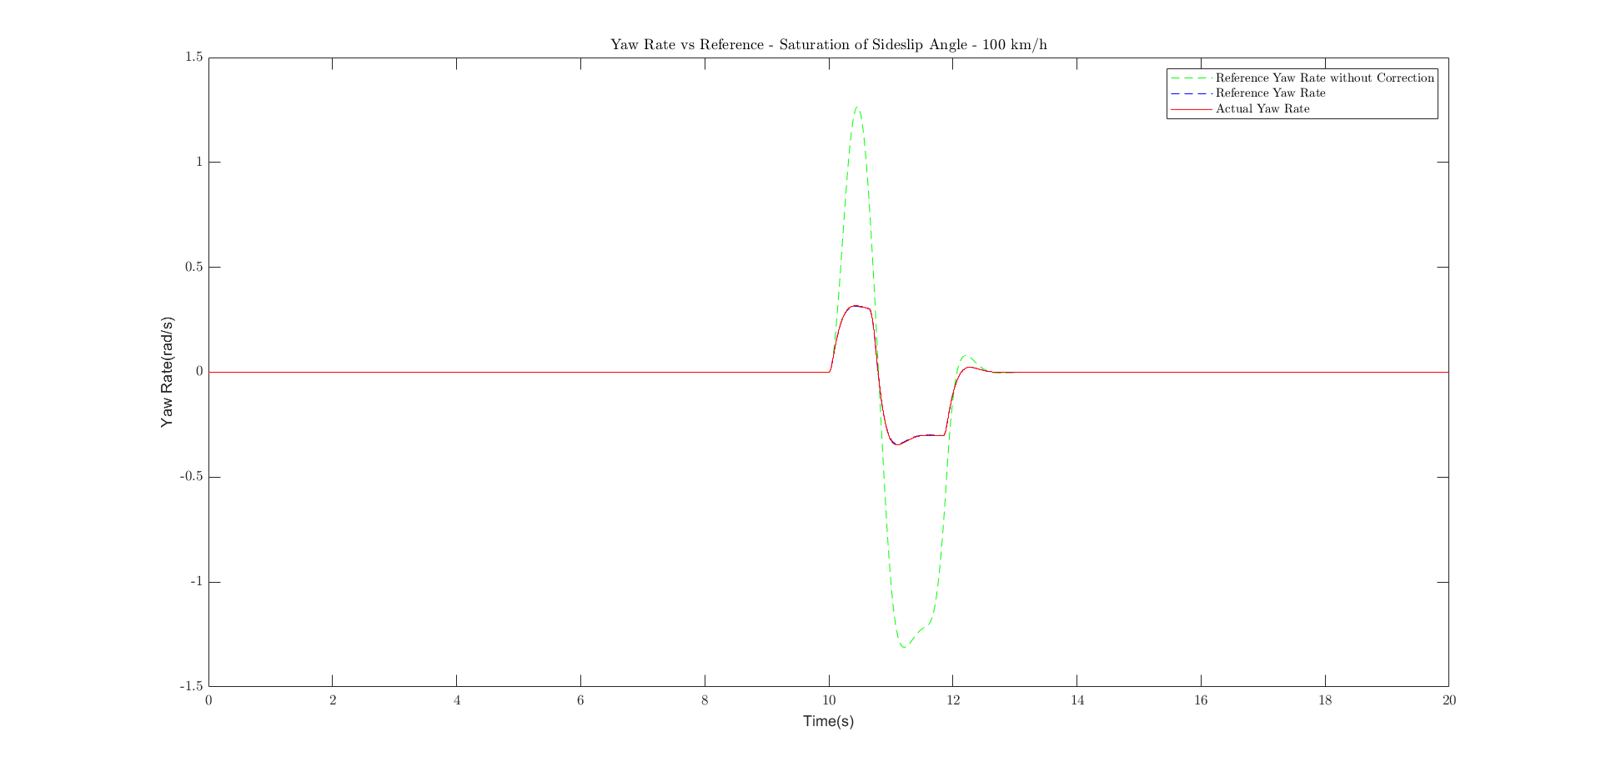
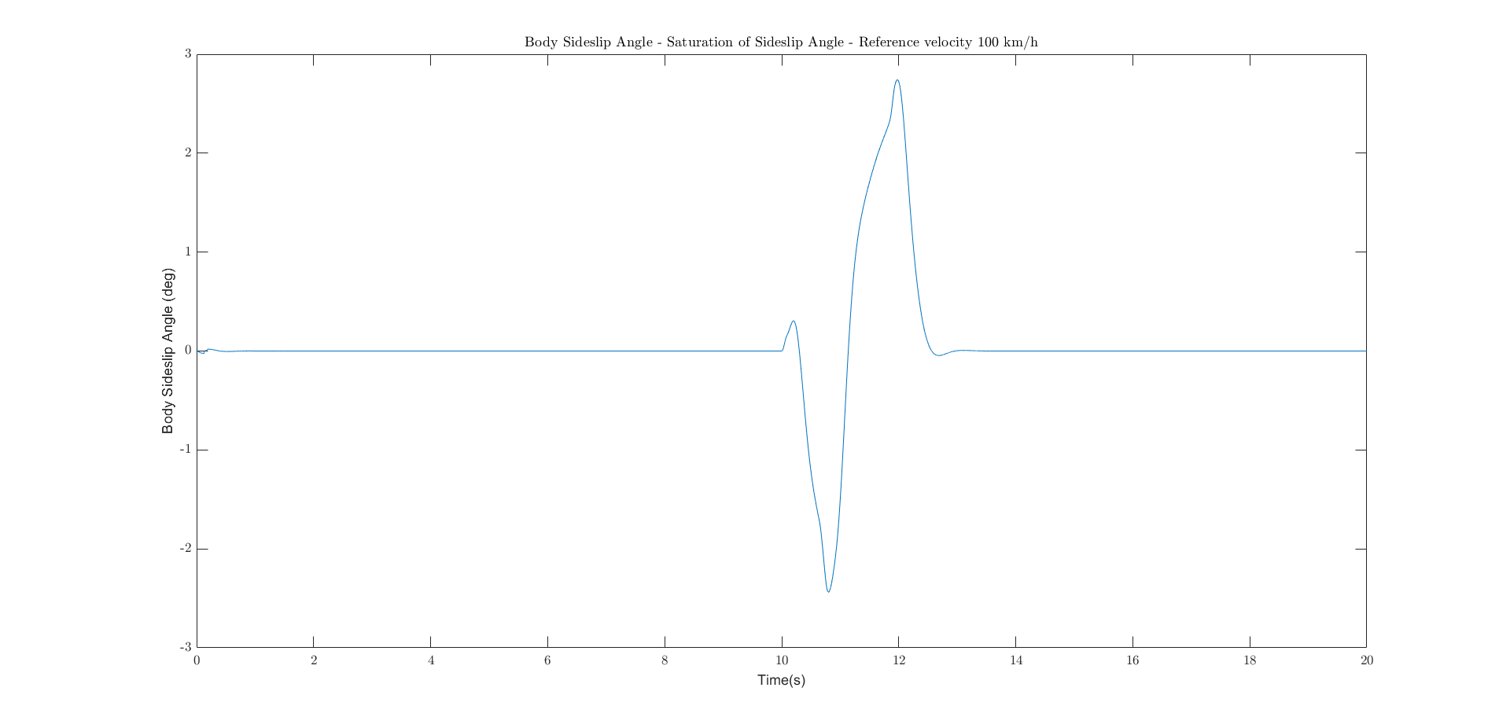
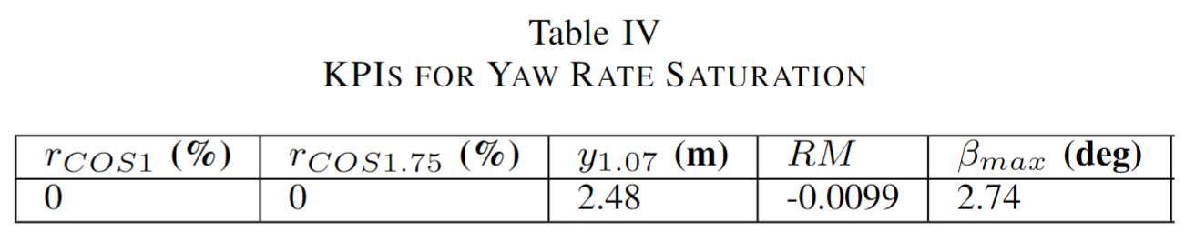
Performance – Yaw Rate Saturation Method

Slide 26
Performance Comparison
PD was difficult to tune and results have noise (chattering)
Other 2 performed well because it used both the measurable quantities (r, a_{y}) thus producing accurate results
Yaw Rate saturation worked way better as it does not just correct the reference depending on the desired slip but also saturates it very well depending on the constraints on sideslip

Slide 27
Conclusions

Slide 28
Conclusions
Sideslip although important criteria for lateral stability, difficult to measure, estimate and control
3 methods explored for sideslip control with DYC
PD Control
Reference Correction
Yaw Rate Saturation
PD was noisy and difficult to tune
The other 2 provided good results with Yaw Rate Saturation proving to be better as it just does not correct the reference yaw rate but saturates it
Notes:
\

Slide 29
Future work

Slide 30
Further Possibilities
Sliding Mode Controller for Sideslip Angle
Model Predictive Control for Sideslip Angle
Active Front Steering (AFS)
Notes:
\

Slide 31
Thank you for your attention ☺
Questions ?

Slide 32
References
[1] – Brightspace – Barys Shyrokau - RO47017 Vehicle Dynamics & Control - 2022. Delft University of Technology
[2] - Jizheng Liu et al. Sideslip Angle Estimation of Ground Vehicles: A Comparative Study
[3] - Federico Cheli et al. A methodology for vehicle sideslip angle identification: comparison with experimental data
[4] - Basilio Lenzo, Mattia Zanchetta, Aldo Sorniotti, Patrick Gruber, and Wouter De Nijs. Yaw rate and sideslip angle control through single input single output direct yaw moment control. IEEE Transactions on Control Systems Technology, 29(1):124–139, 2021
[5] - M Mirzaei. A new strategy for minimum usage of external yaw moment in vehicle dynamic control system. Transportation Research Part C: Emerging Technologies.
[6] - CarSim. The Sine with Dwell Test. 2022. Accessed: 2022-05-22.
Notes:
\

